Slide 1
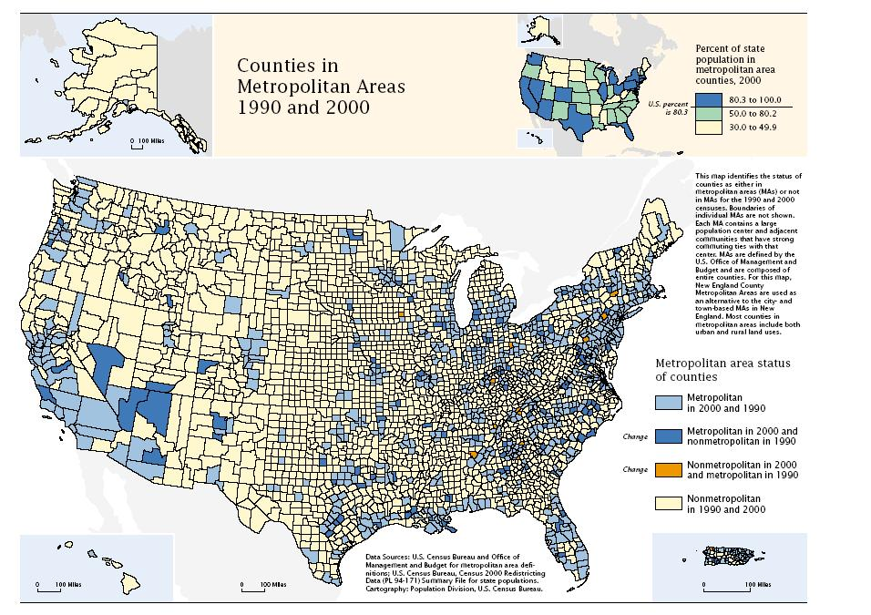
Mapping with arcpy
Brewer, Cynthia A., and Trudy A. Suchan. Mapping Census 2000: The geography of US diversity, 2000: Census 2000 special reports. Vol. 1. No. 1. US Department
of Commerce, Economics and Statistics Administration, US Census Bureau, 2001.
GIS540
Dr. Tateosian
Center for Geospatial Analytics
North Carolina State University
Notes:
This lesson returns to arcpy functionality to discuss the Python mapping capabilities. arcpy can automate map publication and manage existing project documents. The mapping module has Python classes that mimic the organization of ArcGIS Pro. Keep in mind our recent discussion of user-defined classes. The terms property and method will reappear as we go over these mapping classes. In this lecture, you will also see how to manipulate (add, remove, or move) map layers, how to modify map surrounds, such as the title and north arrow, and finally, how to modify the symbology of map layers.

Slide 2
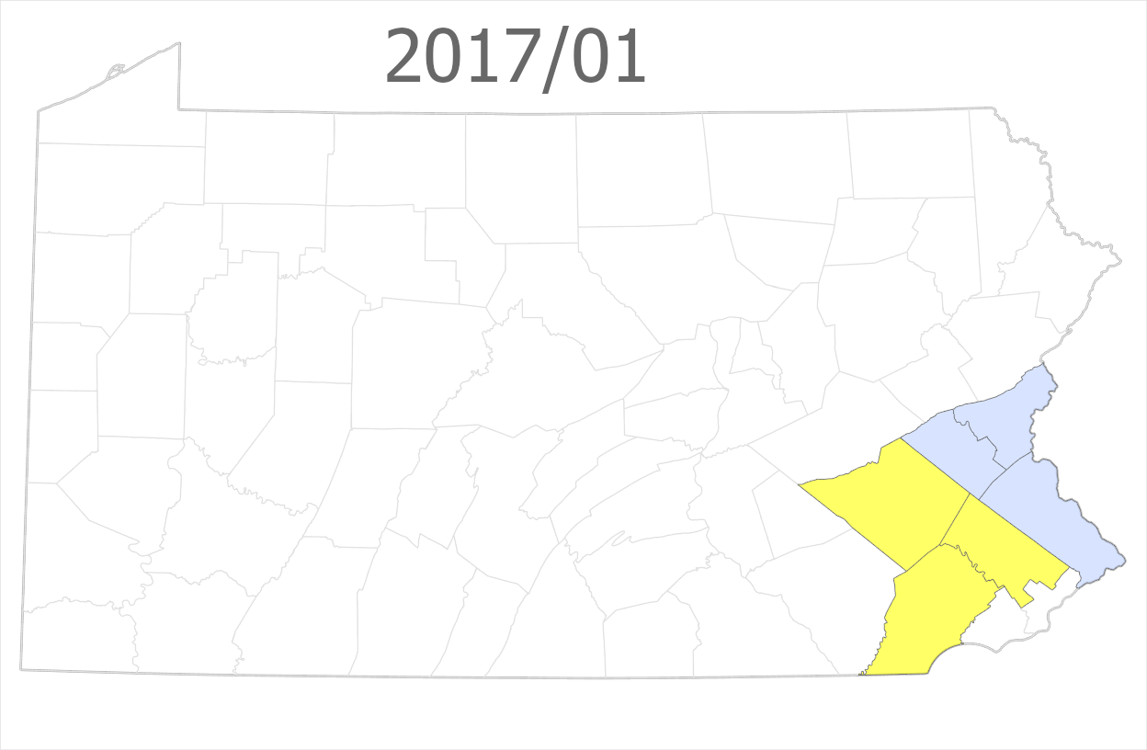
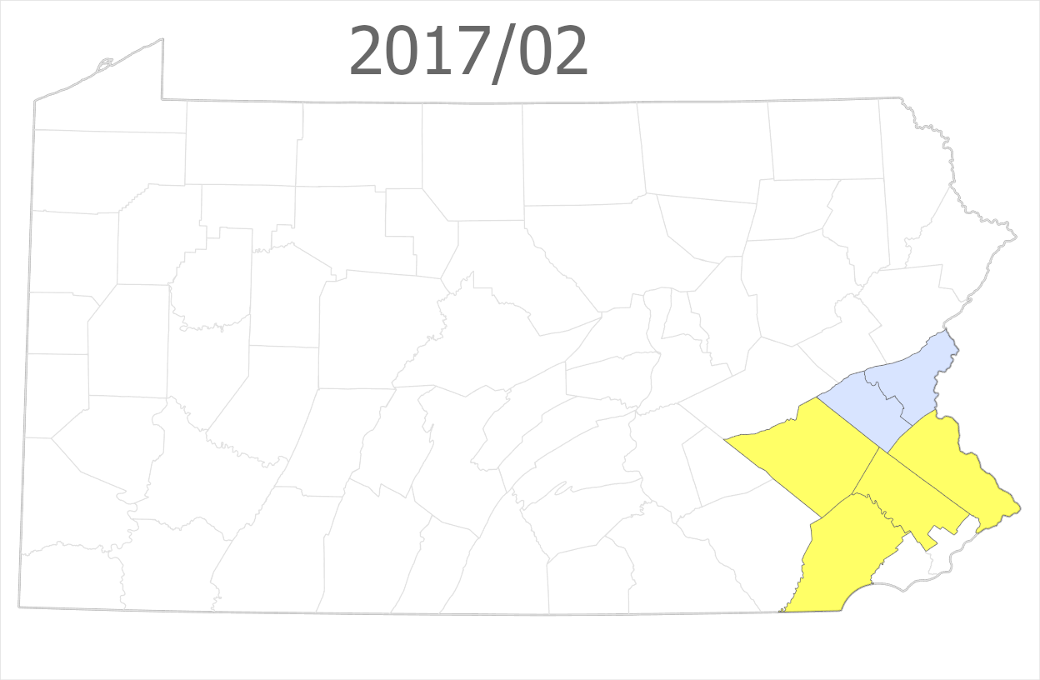
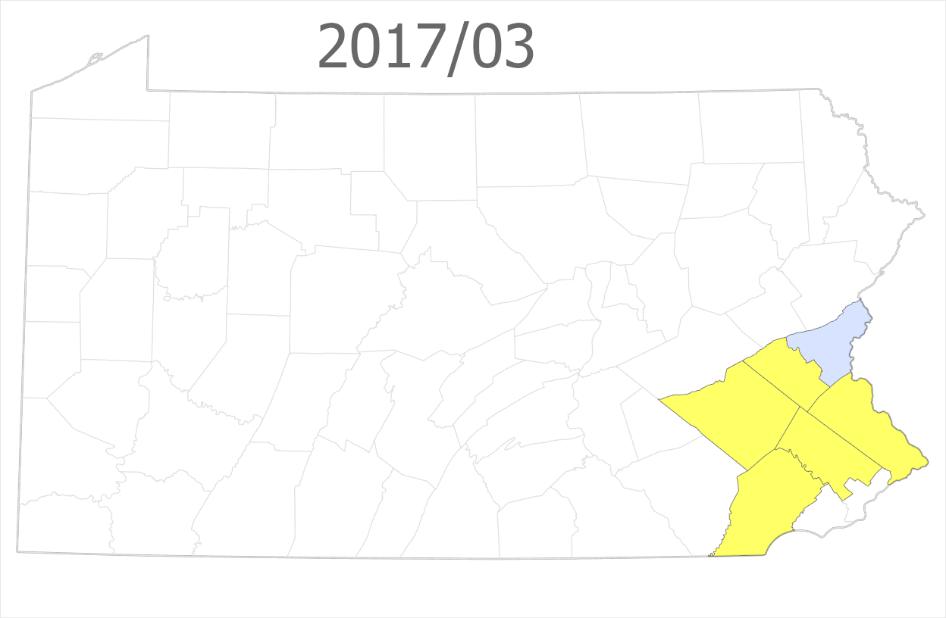
Spotted lanternfly:
2017 official records vs. news articles
time

Slide 3
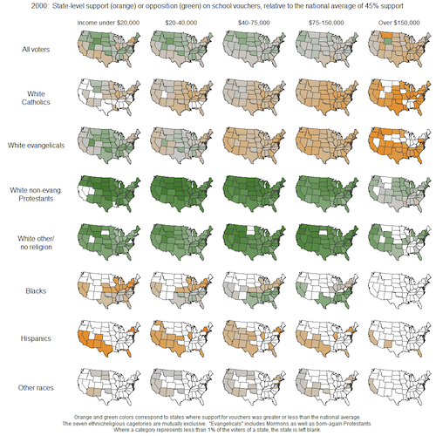
Support for school vouchers
voter
race
income level
Notes:
Small multiples use the same basic map to display different slices of a data set.

Slide 4
title
unique color
graduated color
text
box
legend
scale
Brewer, Cynthia A., and Trudy A. Suchan. Mapping Census 2000: The geography of US diversity, 2000: Census 2000 special reports. Vol. 1. No. 1. US Department of Commerce, Economics and Statistics Administration, US Census Bureau, 2001.

Slide 5
mp
The module for mapping in Python

Slide 6
With mp, you can…
Inventory project contents (list maps, list layer, list elements, etc.)
Add, move, remove data
Symbology (color, size, style, etc.)
Modify layout elements around the map (title, legend, text boxes, etc.)
Export maps (as pdf, png, etc.)
Change base maps

Slide 7
With mp, you can also…
Create new maps and layouts*
Create and add new elements to a layout (title, north arrow, legend, etc.)*
*Capability available in Pro versions >= 3.2

Slide 8
With mp, you cannot…
Create new projects

Slide 9
How it works
Manually:
Create a project.
Use manually created project as a template.
Create and populate a map and a layout using code:
Add layers.
Edit title, text boxes.
Export png or pdf.
Save a copy of the project.
Notes:
You can save a copy of the project. And this allows you to automate your creation of figures.
Or it can be that the mapping stuff is run inside of you script tool and the user runs the script tool and sees the map being updated by the the current map that they're looking at being updated once the script has run.
So that's the general introduction. We'll get into the nitty gritty in the next video.
The mp module is really quite fun because you get to modify the look of your map.

Slide 11
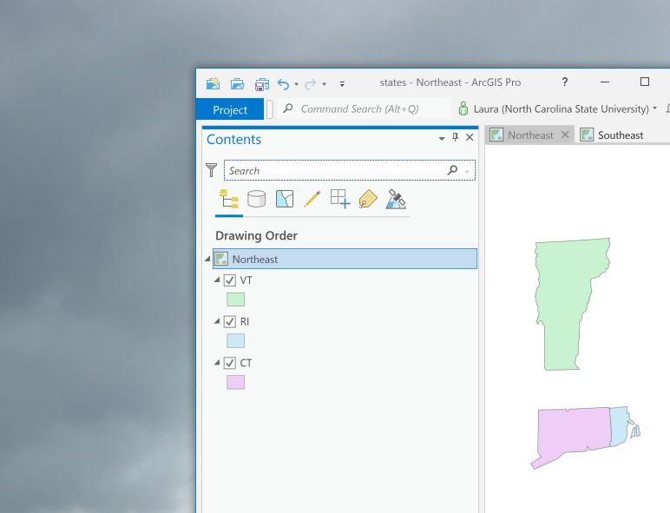
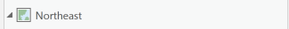
ArcGIS Pro project hierarchy
Project (has maps and layouts)
Map (has layers)
Layers

Slide 12








ArcGIS Pro project hierarchy
Project (has maps and layouts)
Maps (have layers)
Map (has layers)
Layers
Notes:
Showing transition for ArcGIS Desktop to Pro.

Slide 13
Getting a Project object
Scripts need this to work with the maps the project contains.
import arcpy
# Create a Project object.
aprx = arcpy.mp.ArcGISProject("CURRENT")
Project Project object
object constructor
# ... (this is where you would do mapping things.)
# Delete the Project object near the end of the code. del aprx

Slide 14
The “CURRENT” project
Use the project name "CURRENT" to create the Project object when …
working inside ArcGIS Pro. This means running a Jupyter Notebook inside Pro, using the Pro Python window, or in a Script Tool.
Otherwise, you need to specify a project full path file name.
import arcpy
# Create a Project object.
aprx = arcpy.mp.ArcGISProject("CURRENT")
# ... (this is where you would do mapping things)
del aprx
Notes:
Use the project name "CURRENT" to create the Project object when …
working inside ArcGIS Pro. This means in a Notebook, the Python window, or in a Script Tool.
Otherwise, you need to specify a project full path file name.

Slide 15
A project name
Use the project's full path file name to create the Project object when …
working outside of ArcGIS Pro. This means in a PyCharm, Visual Studio Code, other IDEs, a DOS command line, etc.
import arcpy
project_dir = "C:/gispy/data/ch24/projects/states/"
# Create a Project object.
aprx = arcpy.mp.ArcGISProject(project_dir + 'states.aprx')
# ... (this is where you would do mapping things)
del aprx
Notes:
Use the project name "CURRENT" to create the Project object when …
working inside ArcGIS Pro. This means in a Notebook, the Python window, or in a Script Tool.
Otherwise, you need to specify a project full path file name.

Slide 16
Robust project name code
To write code that will work either way, use error handling (try/except keywords)
import arcpy
project_dir = "C:/gispy/data/ch24/projects/states/"
try:
# When working inside ArcGIS Pro,
# use the project name "CURRENT"
aprx = arcpy.mp.ArcGISProject("CURRENT")
except OSError:
# When working outside ArcGIS Pro,
# use the project full path file name.
aprx = arcpy.mp.ArcGISProject(project_dir + "states.aprx")
# ... (this is where you would do mapping things)
del aprx
Notes:
This code will try to use the “CURRENT” project to create the mapping object. If this fails, it will try to use the project specified by this full path file name (project_dir + 'states.aprx') .

Slide 17
If the project & script are together
If script is in the project directory,...
import arcpy, os, sys
project_dir = os.path.dirname(sys.argv[0])
try:
# When working inside ArcGIS Pro,
# use the project name "CURRENT"
aprx = arcpy.mp.ArcGISProject("CURRENT")
except OSError:
# When working outside ArcGIS Pro,
# use the project full path file name.
aprx = arcpy.mp.ArcGISProject(project_dir + "states.aprx")
# ... (this is where you would do mapping things)
del aprx
Notes:
This code will try to use the “CURRENT” project to create the mapping object. If this fails, it will try to use the project specified by this full path file name (project_dir + 'states.aprx') .

Slide 18
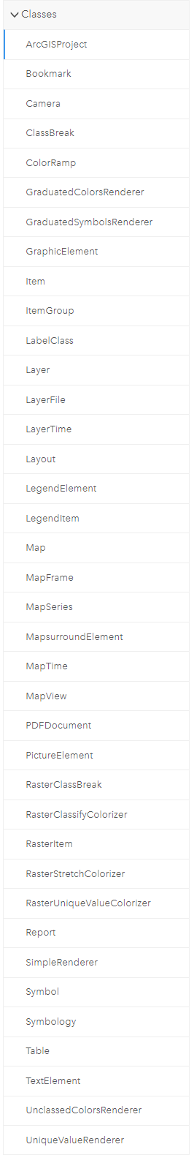
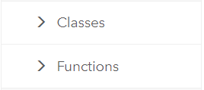
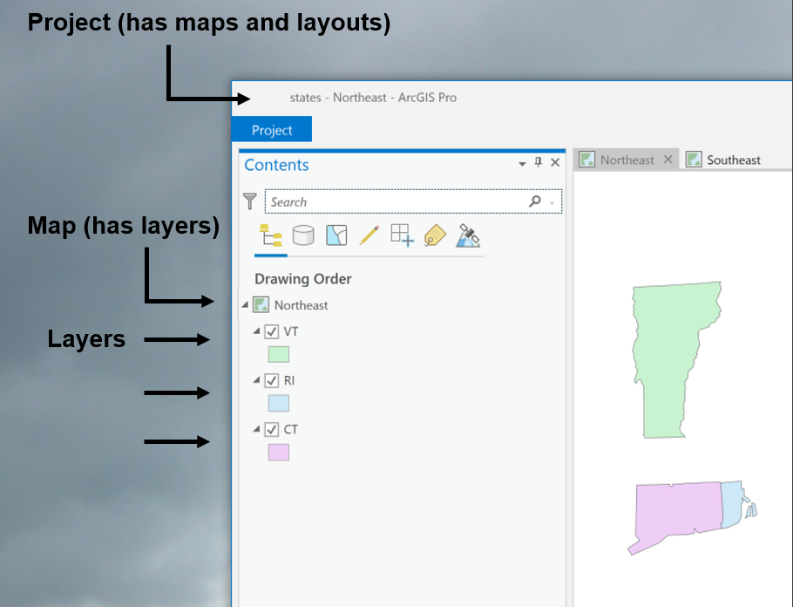
arcpy.mp classes
arcpy.mp module has classes.
Classes: ArcGISProject, Map, Layout, Layer, Symbology, TextElement, and more
Notes:
The mapping module has a set of classes and a set of functions. Looking at the online help for the mapping module, you’ll see a folder for classes (expanded in the left screen shot) and a folder for functions, (expanded in the right screen shot). The classes include a ArcGISProject class, a Map Class, a Layer class, and many others. The functions are grouped into two categories: Functions for exporting and printing the map (most of these are for exporting. you can’t see the entire list here, but there is also a PrintMap function) and then the other category if for managing documents and layers.

Slide 19
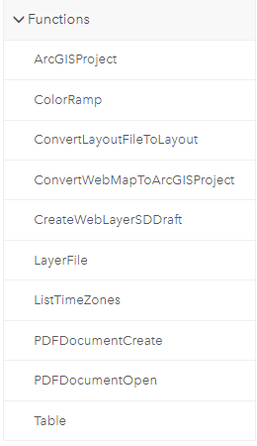
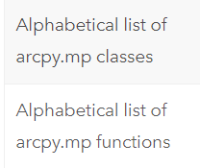
arcpy.mp functions
arcpy.mp module also has functions.
Alphabetical ‘Help’ lists of classes and functions are useful (Print them if using frequently)
aprx = arcpy.mp.ArcGISProject("CURRENT")
ArcGISProject object
object method
Notes:
The arcpy.mp module has a set of classes and a set of functions. Looking at the online help for the mapping module, you’ll see a folder for classes (expanded in the left screen shot) and a folder for functions, (expanded in the right screen shot). The classes include a MapDocument class, a DataFrame Class, a Layer class, and many others. The functions are grouped into two categories: Functions for exporting and printing the map (most of these are for exporting. you can’t see the entire list here, but there is also a PrintMap function) and then the other category if for managing documents and layers.
Notice the alphabetical “help” lists of classes and functions in the left image. These are useful to print so that you can reference them while working with the mapping module.
https://pro.arcgis.com/en/pro-app/latest/arcpy/mapping/alphabeticallistoffunctions.htm

Slide 20
ArcGISProject objects

Slide 21
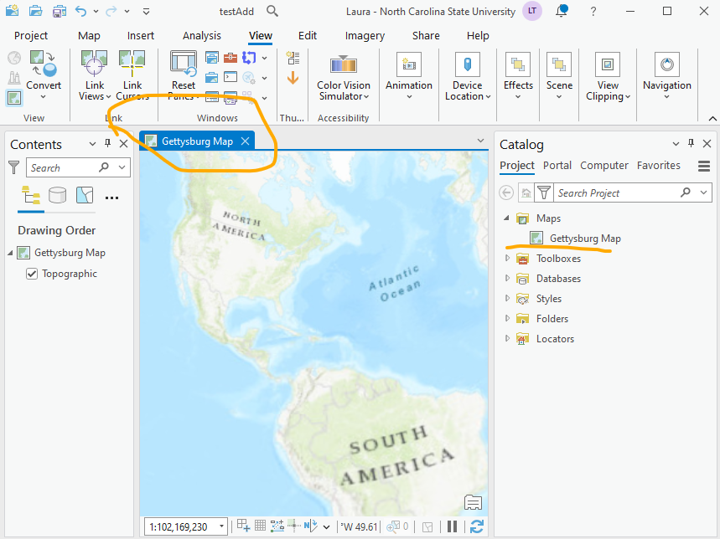
Create a map
import os, sys
project_path = os.path.dirname(sys.argv[0]) + "testAdd.aprx"
aprx = arcpy.mp.ArcGISProject(project_path)
map_object = aprx.createMap("Gettysburg Map")

Slide 22
Create a layout
project_path = os.path.dirname(sys.argv[0]) + "testAdd.aprx"
aprx = arcpy.mp.ArcGISProject(project_path)
myLayout = aprx.createLayout(5, 7, "INCH", "Gettysburg Layout")

Slide 23
Create a data frame
def make_rectangle(llx, lly, w, h):
"""
Specify coordinates in layout coordinates.
Choices are: ['CENTIMETER', 'INCH', 'MILLIMETER', 'POINT']
llx and lly determine the x and y offset from the lower left corner of the layout.
w and h set the width and height of the box.
"""
xyRecList = [[llx, lly], [llx, lly+h], [llx+w,lly+h], [llx+w,lly], [llx,lly]]
array = arcpy.Array([arcpy.Point(*coords) for coords in xyRecList])
rec = arcpy.Polygon(array)
return rec
project_path = os.path.dirname(sys.argv[0]) + "testAdd.aprx"
aprx = arcpy.mp.ArcGISProject(project_path)
myLayout = aprx.createLayout(5, 7, "INCH", "Gettysburg Layout")
mf = myLayout.createMapFrame(make_rectangle(0.5,0.5,4,5), map, "Getty frame1")
map.addDataFromPath(fileName)

Slide 26
Map objects

Slide 27
Project -> Map
import arcpy
aprx = arcpy.mp.ArcGISProject("CURRENT")
# Get a list of Map objects.
maps = aprx.listMaps()
# Get the first Map object.
myMap = maps[0]

Slide 28
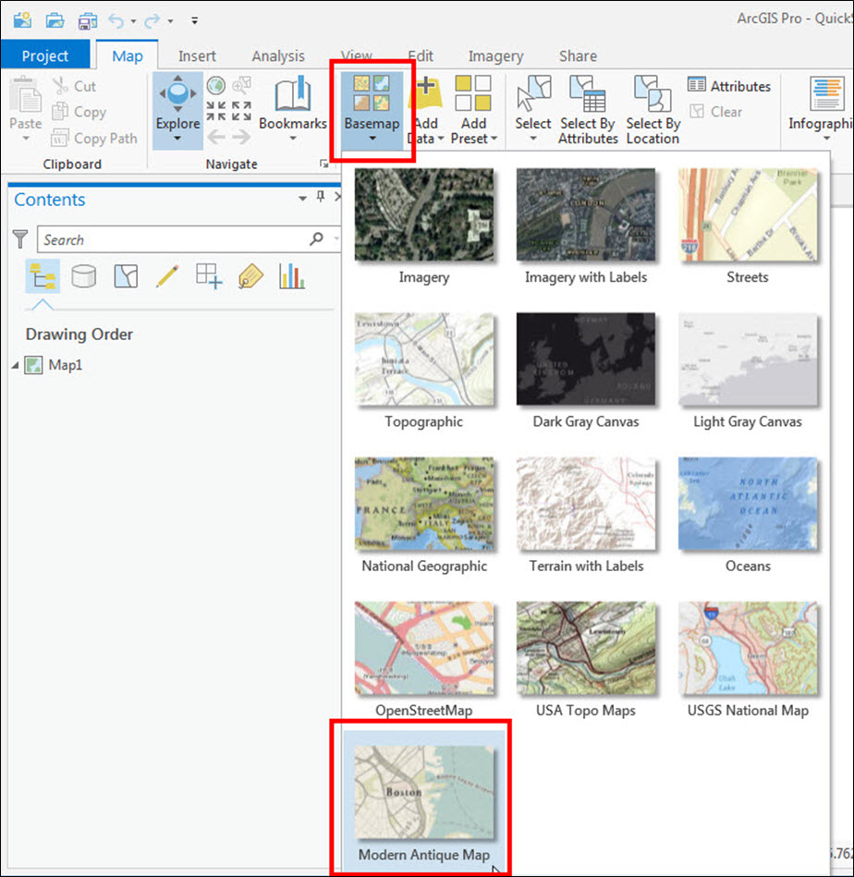
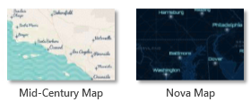
Add a basemap
# Code to get the ArcGIS Project and Map object goes here.
myMap.addBasemap("Modern Antique Map")

Slide 29
addBasemap is a Map object Method
# Code to get the ArcGIS Project and Map object goes here.
myMap.addBasemap("Modern Antique Map")
import arcpy
aprx = arcpy.mp.ArcGISProject("CURRENT")
# Get a list of Map objects.
maps = aprx.listMaps()
# Get the first Map object.
myMap = maps[0]

Slide 30
Manipulate layers and tables
moveLayer--Relative to another layer's position
removeLayer
addLayer --Position choices: AUTO_ARRANGE, TOP, or BOTTOM
insertLayer--Relative to another layer's position
addLayerToGroup
addTable
addTableToGroup
addDataFromPath (data_path)
addBasemap (basemap_name)
Operate on Layer objects or LayerFile
Operate on Table objects
No objects needed

Slide 31

Add data from path example 1
# Code to get the ArcGIS Project and Map objects goes here.
# Add data from a path.
schools = "C:/data/Schools.shp"
myMap.addDataFromPath(schools)
# Does not use the arcpy environment workspace setting.
arcpy.env.workspace = "C:/data/
myMap.addDataFromPath("Schools.shp")
RuntimeError Traceback (most recent call last)...

Slide 32
Add data from path example 2
# Code to get the ArcGIS Project and Map objects goes here.
# Add rasters from a directory.
arcpy.env.workspace = sys.argv[1]
rasts = arcpy.ListRasters()
for rast in rasts: rastFullPath = os.path.join(arcpy.env.workspace, rast)
myMap.addDataFromPath(rastFullPath)
# Add rasters from a directory (Don't use this code!).
arcpy.env.workspace = sys.argv[1]
rasts = arcpy.ListRasters()
for rast in rasts:
myMap.addDataFromPath(rast)
RuntimeError Traceback (most recent call last)...

Slide 33
Move | Remove | Add Layers
Instantiate ArcGISProject and Map objects, then you can…
Move a layer’s position in the table of contents of a map,
Remove a layer from a map
Add layers to a map.

Slide 35
Layer objects

Slide 36
Listing layer objects
import arcpy
aprx = arcpy.mp.ArcGISProject("CURRENT")
# Get a list of Map objects.
maps = aprx.listMaps()
# Get the first Map object.
myMap = maps[0]
# Get a list of Layer objects.
layers = myMap.listLayers()
# Get the first Layer object.
myLayer = layers[0]

Slide 37
Adding and removing layers
# Get the ArcGIS Project and Map objects.
aprx = arcpy.mp.ArcGISProject("CURRENT")
map1 = aprx.listMaps()[0]
map2 = aprx.listMaps()[1]
# Add all 'park' layers in map1 to map2.
park_layers = map1.listLayers("*park*")
for lay in park_layers:
map2.addLayer(lay)
# Remove all layers whose names contain 'park'.
for lay in park_layers:
map1.removeLayer(lay)

Slide 38
RECALL...Project -> Map -> Layer
import arcpy
aprx = arcpy.mp.ArcGISProject("CURRENT")
# Get a list of Map objects.
maps = aprx.listMaps()
# Get the first Map object.
myMap = maps[0]
# Get a list of Layer objects.
layers = myMap.listLayers()
# Get the first layer object.
myLayer = layers[0]

Slide 39
Layer properties
name, visible, dataSource, transparency, isRasterLayer, isFeatureLayer, symbology…
# Get layer's name.
myLayer.name
# Turn layer off.
myLayer.visible = False
# Set layer's transparency.
myLayer.transparency = 20
# Check if layer is a raster.
if myLayer.isRasterLayer:
print("I'm a raster.")
# Get layer's symbology object.
sym = myLayer.symbology

Slide 41
Symbology
# Get layer's symbology object.
sym = myLayer.symbology

Slide 42
Symbology
Feature layers or Raster layers
In Python,
Feature layers use a renderer
Raster layers use a colorizer

Slide 43
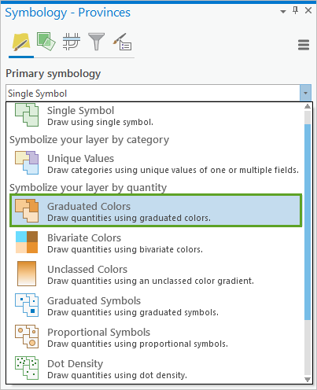
Symbology
Feature layers
Use a renderer
Types of renderers:
1. GraduatedColorsRenderer
2. GraduatedSymbolsRenderer
3. SimpleRenderer
4. UniqueValueRenderer
5. UnclassedColorRenderer

Slide 44
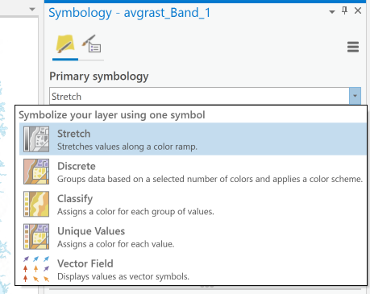
Symbology
Raster layers
Use colorizers
Types of colorizers:
1. RasterClassifyColorizer
2. RasterUniqueValueColorizer
3. RasterStretchColorizer

Slide 45
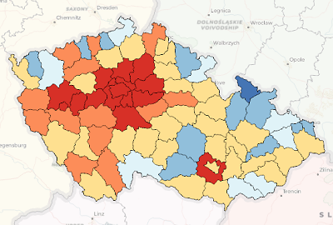
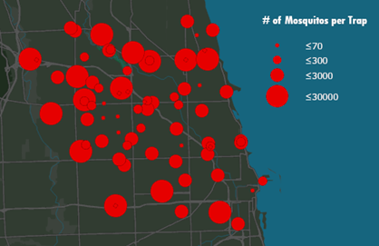
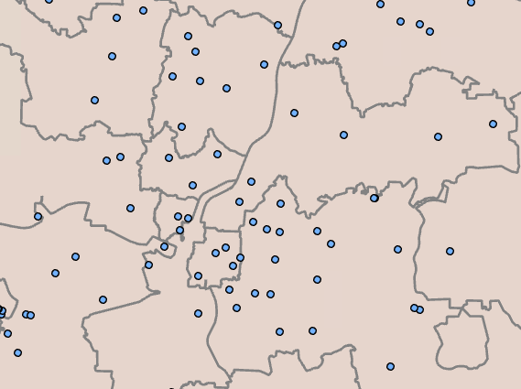
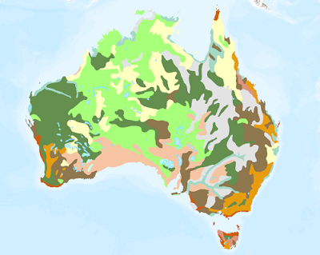
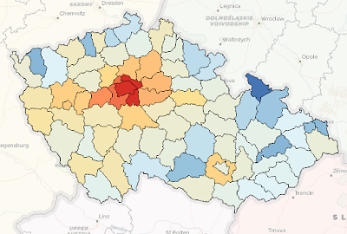
Symbology For Feature layers
1. GraduatedColorsRenderer
show a quantitative difference between mapped features by varying the symbol colors (e.g., binned colors)
2. GraduatedSymbolsRenderer
show a quantitative difference between mapped features by varying the symbol sizes
3. SimpleRenderer
apply the same symbol to all features in a layer
4. UniqueValueRenderer
symbolize qualitative categories of values
5. UnclassedColorsRenderer
show quantitative differences in feature values with a continuous color ramp
Notes:
https://pro.arcgis.com/en/pro-app/latest/help/mapping/layer-properties/symbolize-feature-layers.htm

Slide 46
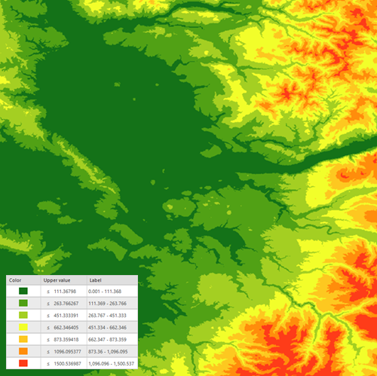
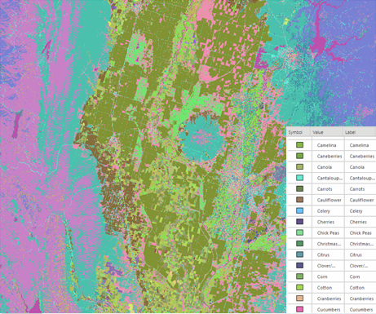
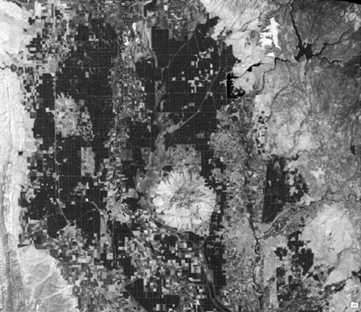
Symbology for Raster Layers
RasterClassifyColorizer
group pixels in a specified number of classes
2. RasterUniqueValueColorizer
randomly assigns a color to each value in a dataset
3. RasterStretchColorizer
define the range of values to be displayed & apply a continuous color ramp to those values
Notes:
https://pro.arcgis.com/en/pro-app/latest/help/data/imagery/symbology-pane.htm

Slide 47
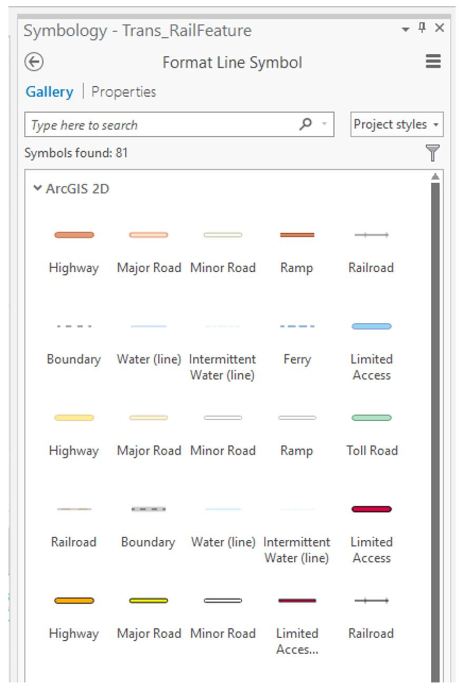

Slide 48
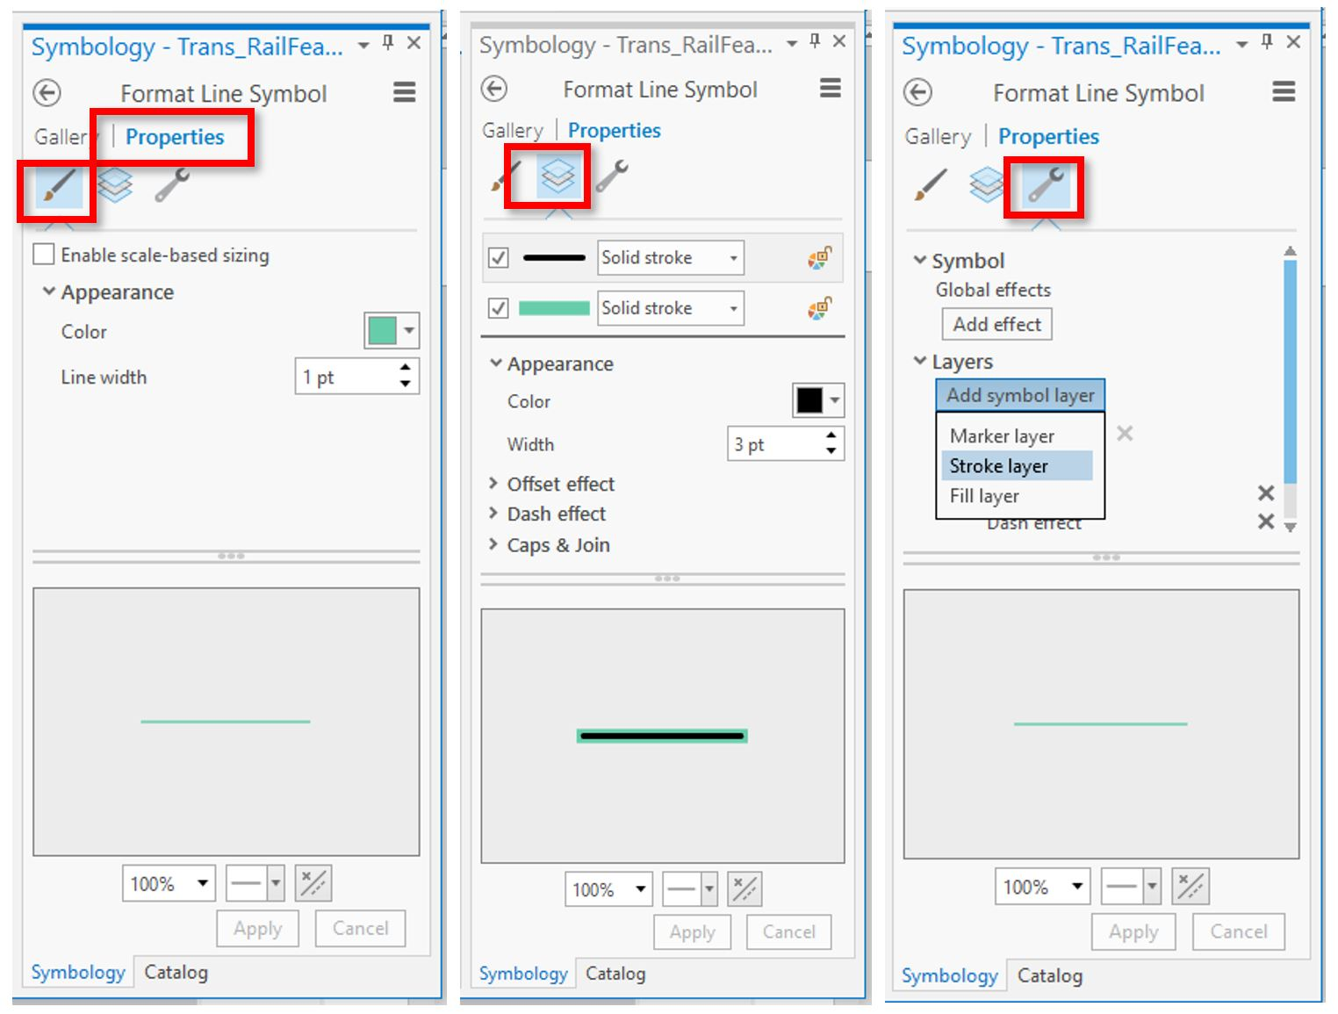

Slide 49
Workflow for modifying symbology
# Get the ArcGISProject object.
# Get the Map object.
# Get the Layer object.
# Get the Layer’s Symbology object in a variable.
# Modify the properties of the renderer of the copied Symbology object.
# Set the layer’s Symbology property to the modified symbology.

Slide 50
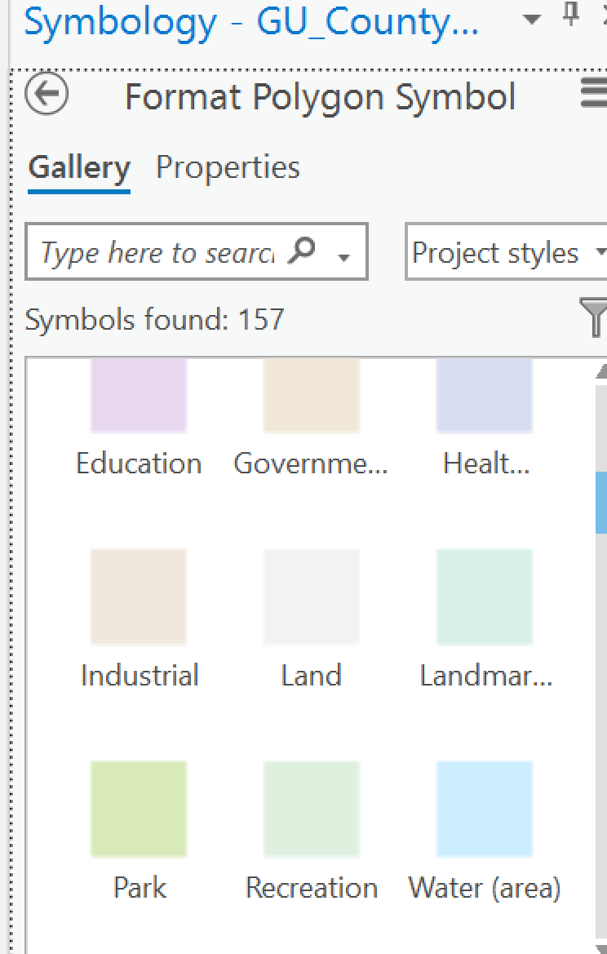
Using a Gallery Style
# Get ArcGISProject, Map, and Layer objects.
import arcpy
aprx = arcpy.mp.ArcGISProject("CURRENT")
maps = aprx.listMaps()
myMap = maps[0]
layers = myMap.listLayers()
myLayer = layers[0]
# Get the Symbology object of the Layer object.
sym = myLayer.symbology
# Modify the Symbology object.
sym.renderer.symbol.applySymbolFromGallery("Park")
# Set the Layer object’s symbology.
myLayer.symbology = sym

Slide 51
Specifying color
{'RGB' : [255, 0, 0, 100]}

Slide 52
Specifying color
Color model
{'RGB' : [255, 0, 0, 100]}

Slide 53
Specifying color
Color model
Color values
{'RGB' : [255, 0, 0, 100]}

Slide 54
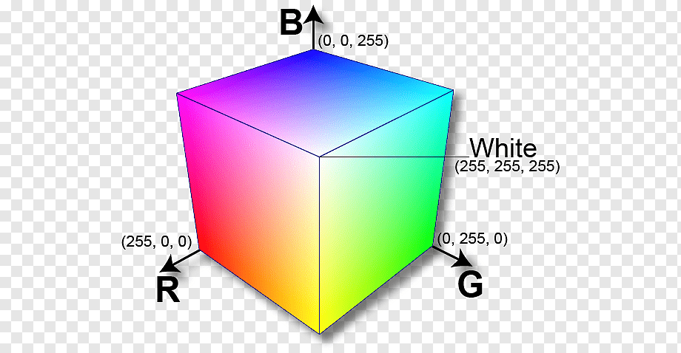
Specifying color
Color model
Color values
{'RGB' : [255, 0, 0, 100]}
[Red, Green, Blue, Alpha]
Red, Green, and Blue have range 0 to 255
red = 255 means very red
green = 130 means moderately green
blue = 0 means no blue
Alpha is opacity
alpha = 0 means fully transparent
alpha = 70 means 30% transparent
alpha = 100 means not all transparent

Slide 55
Specifying color
Color model
Color values
{'RGB' : [255, 0, 0, 100]}
{'CMYK' : [Cyan, Magenta, Yellow, Black, Alpha]}—Read/Write
{'HSL' : [Hue, Saturation, Lightness, Alpha]}—Read/Write
{'HSV' : [Hue, Saturation, Value, Alpha]}—Read/Write
{'RGB' : [Red, Green, Blue, Alpha]}—Read/Write
{'Lab' : [Lightness, a, b, Alpha]}—Read-only
{'Grayscale' : [Gray, Alpha]}—Read-only
[Red, Green, Blue, Alpha]

Slide 56
Setting a feature layer’s color
>>> print(myLayer.symbology.renderer)
# Get the layer’s Symbology object
sym = myLayer.symbology
# Change the fill color.
sym.renderer.symbol.color = {'RGB' : [255, 0, 125, 75]}
# Change the border color.
sym.renderer.symbol.outlineColor = {'RGB' : [255, 0, 0, 100]}
# Set the layer's symbology with these changes.
myLayer.symbology = sym
<arcpy._renderer.SimpleRenderer object at 0x00000213750C3108>

Slide 57
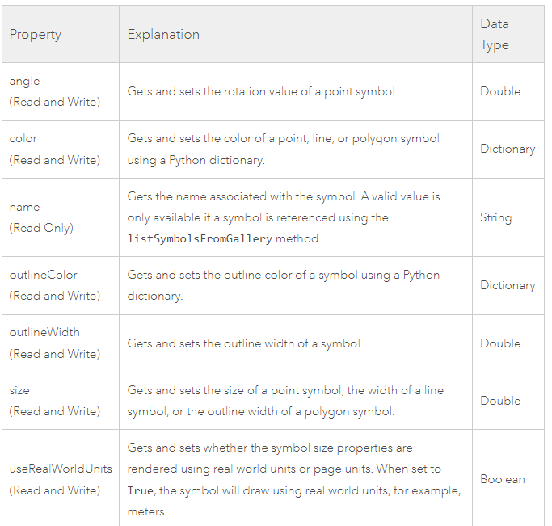
Symbology properties

Slide 58
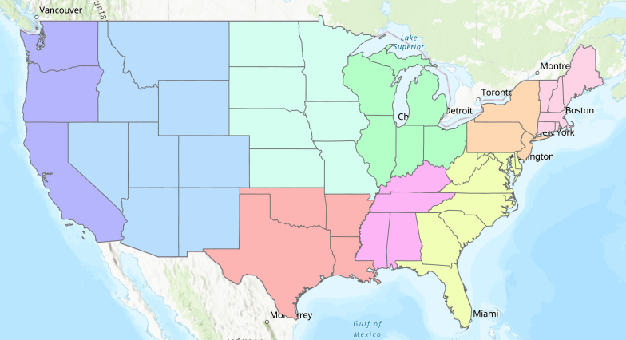
Changing the renderer
# Get the layer’s Symbology object
sym = myLayer.symbology
# Change from the default SimpleRenderer (all one color)
# to the UniqueValueRenderer
sym.updateRenderer('UniqueValueRenderer')
# Use the zip code number for color uniqueness.
sym.renderer.fields = ['Sub_Region']
# Set the layer's symbology with these changes.
myLayer.symbology = sym

Slide 59
Setting values in unique value renderer
sym = myLayer.symbology
sym.updateRenderer("UniqueValueRenderer")
sym.renderer.fields = ["Oil_Flow"]
for grp in sym.renderer.groups:
for item in grp.items:
value = item.values[0][0]
if value == "Heavy":
item.symbol.color = {'RGB': [250, 52, 17, 100]}
item.symbol.size = 2
item.label = str(value)
if value == "Moderate":
item.symbol.color = {'RGB': [255, 170, 0, 100]}
item.symbol.size = 1.5
item.label = str(value)
if value == "Light":
item.symbol.color = {'RGB': [255, 255, 0, 100]}
item.symbol.size = 1
item.label = str(value)
myLayer.symbology = sym

Slide 60
Setting labels with a lookup table
roadDict = {"1": "Highway",
"2": "Secondary highway",
"3": "Local connecting road"}
sym.updateRenderer('UniqueValueRenderer')
sym.renderer.fields = ['tnmfrc']
for grp in sym.renderer.groups:
# Change the subheading from tmnrfc to Road type.
grp.heading = "Road type"
for item in grp.items:
value = item.values[0][0]
if value in roadDict:
item.symbol.color = {'RGB': [250, 52, 17, 100]}
item.symbol.size = 2
item.label = str(roadDict[value])
if 4 <= int(value) <= 6:
item.symbol.color = {'RGB': [255, 170, 0, 100]}
item.symbol.size = 1.5
if 7 <= int(value) <= 8:
item.symbol.color = {'RGB': [60, 60, 60, 100]}
item.symbol.size = 1
myLayer.symbology = sym

Slide 62
title
unique color
graduated color
text
box
legend
scale
Brewer, Cynthia A., and Trudy A. Suchan. Mapping Census 2000: The geography of US diversity, 2000: Census 2000 special reports. Vol. 1. No. 1. US Department of Commerce, Economics and Statistics Administration, US Census Bureau, 2001.

Slide 63
Layout objects

Slide 64
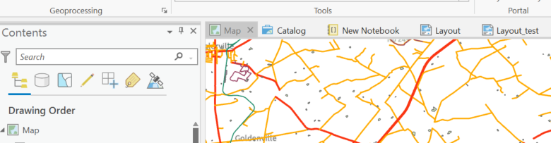
Project -> Layout
import arcpy
aprx = arcpy.mp.ArcGISProject("CURRENT")
# Get a list of Layout objects.
layouts = aprx.listLayouts()
# Get the first Layout object.
myLayout = layouts[0]

Slide 65
List layout elements
listElements is a Layout method
Two optional parameters: {element_type}, {wildcard}
To list all the element objects in a layout,
import arcpy
aprx = arcpy.mp.ArcGISProject("CURRENT")
myLayouts = aprx.listLayouts()
myLayout = myLayouts[0]
allElems = myLayout.listElements()

Slide 66
Project -> Layout -> Elements
import arcpy
aprx = arcpy.mp.ArcGISProject("CURRENT")
# Get a list of Layout objects.
layouts = aprx.listLayouts()
# Get the first Layout object.
myLayout = layouts[0]
# Get the layout elements.
elems = myLayout.listElements()
# Get the first layout element. firstElem = elems[0]

Slide 67
Modify scale
# Before running this code: # 1) Insert a layout manually.
# 2) Add a map frame to the layout manually.
import arcpy
aprx = arcpy.mp.ArcGISProject("CURRENT")
# Get the Layout object
myLayouts = aprx.listLayouts()
theLayout = myLayouts[0]
elems = theLayout.listElements()
# Get the mapframe element (zero index if you added this first).
mf = elems[0]
# Zoom out by 5%
mf.camera.scale = mf.camera.scale * 1.05
# OR set the scale explicitly
# Set the scale to 1:50000
mf.camera.scale = 50000

Slide 68
Pan
# Before running this code: # 1) Insert a layout manually.
# 2) Add a map frame to the layout manually.
import arcpy
aprx = arcpy.mp.ArcGISProject("CURRENT")
# Get the Layout object
myLayouts = aprx.listLayouts()
theLayout = myLayouts[0]
elems = theLayout.listElements()
mf = elems[0]
# Center the map in York County
mf.camera.X = -76.9
mf.camera.Y = 39.769

Slide 69
Element types
Two optional parameters: {element_type}, {wildcard}
import arcpy
aprx = arcpy.mp.ArcGISProject("CURRENT")
myLayouts = aprx.listLayouts()
pics = myLayout.listElements('PICTURE_ELEMENT')
horseLabels = myLayout.listElements('TEXT_ELEMENT','HOR*')
'GRAPHIC_ELEMENT'
'LEGEND_ELEMENT'
'MAPFRAME_ELEMENT'
'MAPSURROUND_ELEMENT'
'PICTURE_ELEMENT'
'TEXT_ELEMENT'

Slide 70
Managing layout elements
arcpy CAN’T create new elements entirely from scratch.
Can clone text elements.
For projects where you want to modify layout elements, use an existing layout as a template to modify.
Template map elements can be ‘hidden’ outside the initial viewing box.
Notes:
myElements = myLayout.listElements()
for e in myElements:
print(e.name)

Slide 71
Access elements by name
Getting a layout element to modify its properties, can use element name.
When you add an element to a layout, it gets a name.
Use meaningful names for each element in the template map.
import arcpy
aprx = arcpy.mp.ArcGISProject("CURRENT")
myLayouts = aprx.listLayouts()
myLayout = myLayouts[1]
for elem in myLayout.listElements():
print(elem.name)
Text 1
Text
North Arrow
Scale Bar
Legend
Map Frame
Notes:
myElements = myLayout.listElements()
for e in myElements:
print(e.name)

Slide 72
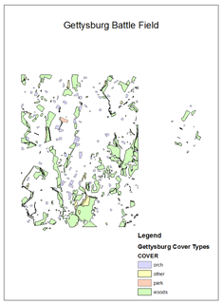
Accessing text elements by text
import arcpy
aprx = arcpy.mp.ArcGISProject(r"C:\Projects\proj.aprx")
myLayouts = aprx.listLayouts()
myLayout = myLayouts[1]
text_elems = myLayout.listElements("TEXT_ELEMENT")
for elm in text_elems:
if elm.text == "YEAR":
elm.text = "2009"
2009
Notes:
myElements = myLayout.listElements()
for e in myElements:
print(e.name)

Slide 73
Explain what the code does…
Part 1:
import arcpy
aprx = arcpy.mp.ArcGISProject(r"C:\Projects\proj.aprx")
myLayouts = aprx.listLayouts()
myLayout = myLayouts[1] arrow = myLayout.listElements('MAPSURROUND_ELEMENT','*Arrow*')[0] arrow.name u'North Arrow'
Part 2:
elems = myLayout.listElements()
for e in elems: print(e.name) Text Box North Arrow Legend Title Layers
for e in elems: if 'Title' in e.name: title = e
mfs = myLayout.listElements('MAPFRAME_ELEMENT')
mf = mfs[0]
title.elementPositionX = mf.elementPositionX + (mf.elementWidth*0.5) - (title.elementWidth*0.5)
title.elementPositionY = mf.elementPositionY + mf.elementHeight - title.elementHeight

Slide 74
Explain what the code does…
# Print the name of the north arrow.
Part 1:
import arcpy
aprx = arcpy.mp.ArcGISProject(r"C:\Projects\proj.aprx")
myLayouts = aprx.listLayouts()
myLayout = myLayouts[1] arrow = myLayout.listElements('MAPSURROUND_ELEMENT','*Arrow*')[0] arrow.name u'North Arrow'
Part 2:
elems = myLayout.listElements()
for e in elems: print(e.name) Text Box North Arrow Legend Title Layers
for e in elems: if 'Title' in e.name: title = e
mfs = myLayout.listElements('MAPFRAME_ELEMENT')
mf = mfs[0]
title.elementPositionX = mf.elementPositionX + (mf.elementWidth*0.5) - (title.elementWidth*0.5)
title.elementPositionY = mf.elementPositionY + mf.elementHeight - title.elementHeight
# Print the names of all the elements.
# Get the last element with Title
in the name.
# Move the Title to the
# center (top) of the first map frame

Slide 75
Exporting images

Slide 76
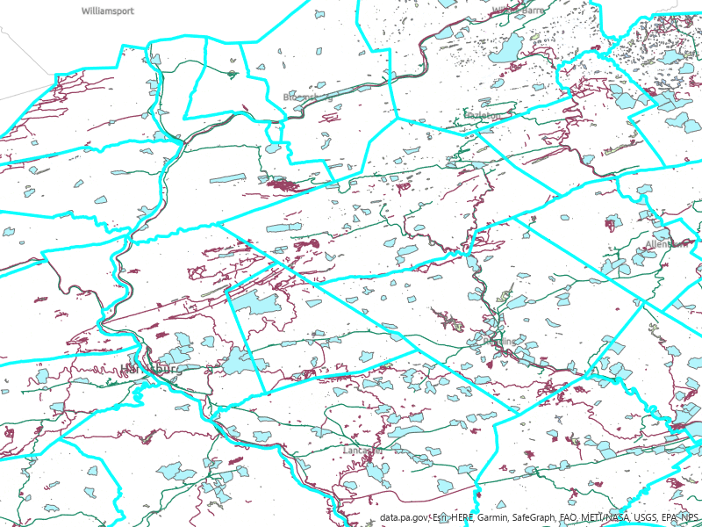


Export map to PNG
## Export the default map view to png.
import arcpy
aprx = arcpy.mp.ArcGISProject("C:/gispy/test.aprx")
# Get the first map in this project.
myMap = aprx.listMaps()[0]
myMap.defaultView.exportToPNG("C:/gispy/scratch/PAmap.png",
width=800, height=600)
del myMap
del aprx
Project object
Map object
MapView object

Slide 77


Export mapframe to PNG
## Export the default map view to png.
import arcpy
aprx = arcpy.mp.ArcGISProject("C:/gispy/test.aprx")
# Get the first Layout in this project.
myLayout = aprx.listLayouts()[0]
mf = myLayout.listElements()[0]
mf.exportToPNG("C:/gispy/scratch/foo.png", resolution=50)
del aprx
Project object
Layout object
MapFrame object

Slide 78

Export layout to PNG
Planned Parks & Development
## Export the default map view to png.
import arcpy
aprx = arcpy.mp.ArcGISProject("C:/gispy/test.aprx")
# Get the first Layout in this project.
myLayout = aprx.listLayouts()[0]
myLayout.exportToPNG("C:/gispy/scratch/foo.png", resolution=50)
del aprx
Project object
Layout object

Slide 79
Mapping object summary
ArcGISProject objects:
listMaps and listLayouts methods
Map objects:
listLayers method
Layout objects:
listElements method
Layer objects:
symbology property
Symbology objects:
renderer or colorizer properties

Slide 80
Mapping functionality summary
Add data to a map
Move, remove layers
Modify layer symbology
Modify layout elements
Export (map or layout) to image

Slide 81
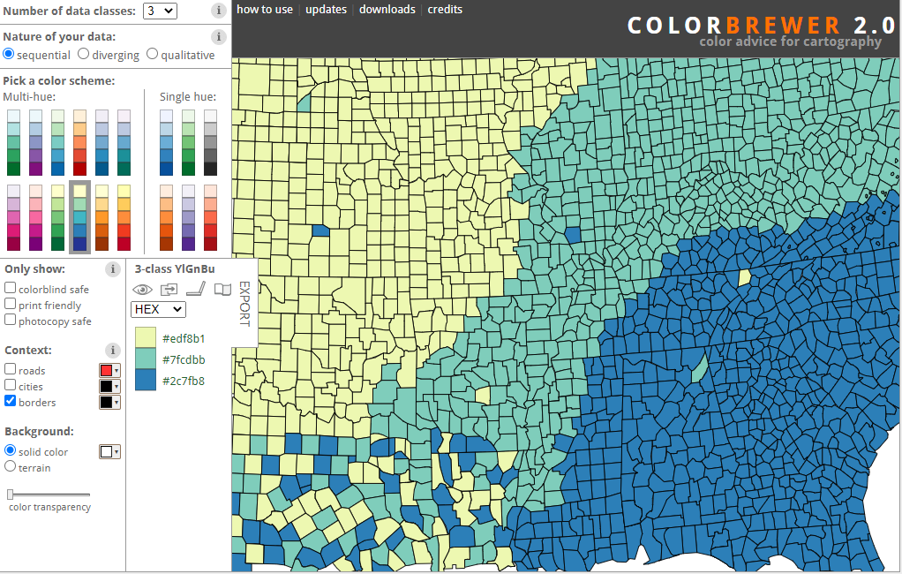
For selecting colors

